Slide 1
Virtual Screening for SHP-2 Specific Inhibitors Using Grid Computing
By
Simon Han
UCSD Bioengineering ’09
November 18-21, 2008
SC08, Austin, TX
Notes:
Hi, I’m Simon. Over the summer I used the virtual screening grid platform to look for inhibitors for SHP2 in the Cybermedia Center in Osaka University, Japan. The result is that there are several possible inhibitors that we’d like to verify in the lab.

Slide 2
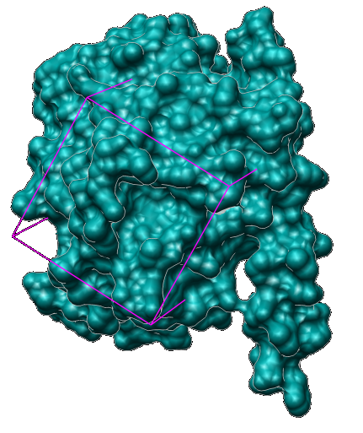
What is SHP2?
Protein Tyrosine Phosphatase
  De-phosphorylate
  Participates in cellular signaling pathways
Cellular Functions
  Development
  Growth
  Death
Disease Implications
  Alzheimer's
  Diabetes
  Cancer
Research Objective
  To identify possible inhibitors further research SHP2
Fig 1.
The purple box represents the binding site
Notes:
What is SHP2? SHP2 is a protein tyrosine phosphatase that dephosphorylates substrates. This step is instrumental in many metabolic pathways that controls a host of cellular functions such as , , and . These functions have significant implications in disease pathways such as , , and . So with specific inhibitors, we can better study the functions of the protein and eventually help find a drug/cure that will benefit patients with these ailments.

Slide 3
Virtual Screening Steps
DOCK6
  Built-in MPI functionality
  Deployable over the Grid with Opal Op (grid middleware)
Strategies
  Preliminary screen
  Re-screen
  AMBER screen
ZINC7 Databases screened
  Free database
  Compounds readily purchasable from vendors
  “drug-like” (2,066,906 compounds)
  “lead-like” (972,608 compounds)
Notes:
Approximately 55,000 of the original 3 million compounds were ranked after all three screens

Slide 4
Grid Resources
Table 1. Resources Used
Cluster | Processors | Processors | Location
 | Total | Used
Rocks-52 | 28 | 6-16 | SDSC, US
Tea01 | 80 | 28-48 | Osaka U, JP
Cafe01 | 64 | 9-26 | Osaka U, JP
Ocikbpra | 32 | 6-26 | U of Zurich, CH
Lzu | 22 | 14-21 | LanZhou U, CN
Used 5 clusters spanning diverse locations in North America, Asia, and Europe
Processors used is a range to accommodate resource availability

Slide 5
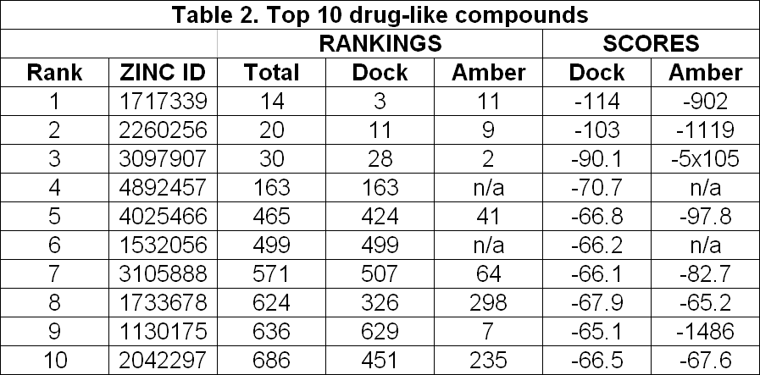
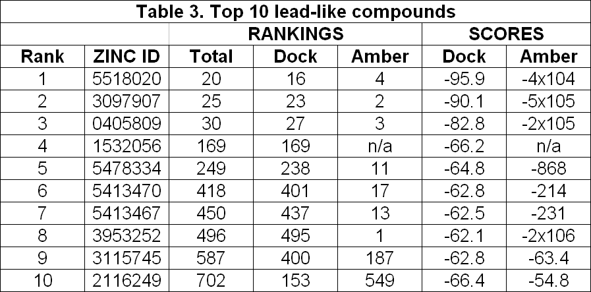
Results
Consensus Docking
  “Rank” is the final rank
  “Total” is the sum of DOCK and AMBER ranks
  “ZINC ID” is the compound code
Rank sorted by the least energy score
Some AMBER scores are abnormally minimized
  Requiring addition data verification

Slide 6
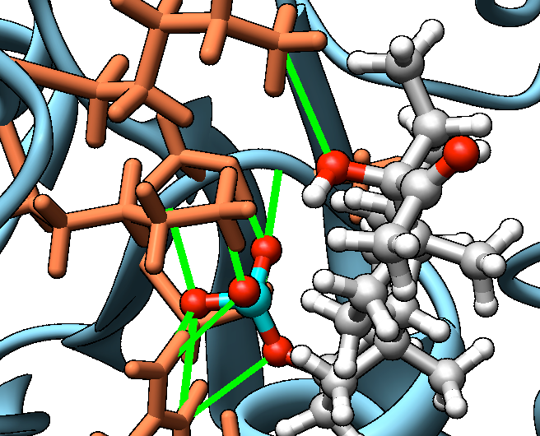
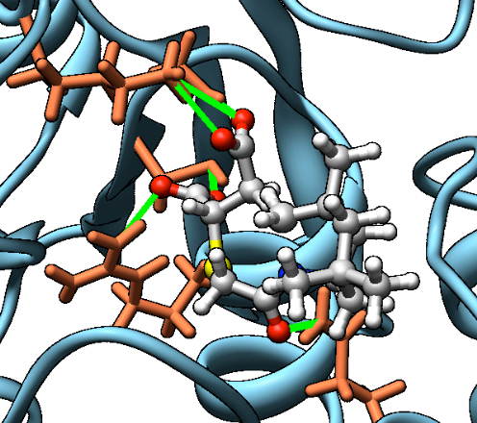
Example of Visualization
Compound interaction
  Ball n’ stick: compound
  Blue spirals: SHP2 binding site
  Orange sticks: amino acid residues
  Green lines: Hydrogen bonds
    Indicate intense interaction between compound and SHP2
Chemical motifs
  Fig 2 and 3 show phosphonic acids
  Others: sulfonic acids, phosphinic acids, butanoic acids, carboxylic acids
  Sulfonic acids and phosphinic acids tend rank high and unreliable
Fig 2. ZINC 4025466
Fifth ranked compound from “drug-like” results
Fig 3. ZINC 5413470
Sixth ranked compound from “lead-like” results
Notes:
Both are phosphonic acids

Slide 7
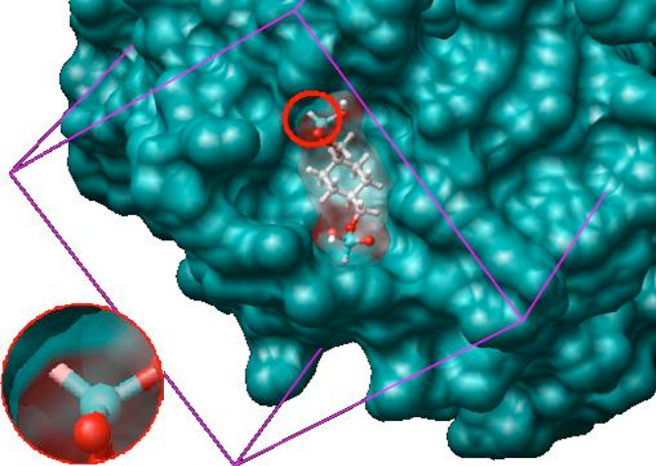
Example of Imbedded Compound
DOCK is not perfect
Visual confirmation of results is necessary
Abnormally low energy score due to unnatural interaction of compound and SHP2
  A hydrogen atom is embedded in SHP2
Fig 4. ZINC 1717339
Top ranked “drug-like” compound
AMBER energy score: -902
Notes:
Now you might wonder why the top ranked compounds weren’t shown. That is because like any program, the dock software isn’t perfect. Here is the top ranked drug-like compound visualized. You can clearly see that part of the ligand is embedded in SHP2.

Slide 8
Grid Related Issues
Uncontrollable by user:
  Cluster maintenance, power outages
Cluster specific issues:
  Inconsistent calculations
  Defunct processes on rocks-52 and cafe01
Unforeseen heavy usage of clusters
  May highlight the need for smarter schedulers

Slide 9
Disk Space Issues
Table 4. Disk Space Usage
Cluster | Space Used
Rocks-52 | 38GB
Tea01 | 94GB
Cafe01 | 111GB
Ocikbpra | 30GB+
Lzu | 52GB
Total | 325GB+
Unmonitored use can inconvenience others
Huge amounts of data may be hard to manage
Compressing data adds a layer of complexity to data management
Virtual screenings generate huge amounts of data
Routine and repeated screenings can quickly fill hard drives
Newer ZINC8 databases contains over 8 million compounds
  For an AMBER screen, input files would require over 20 Tetrabytes

Slide 10
Conclusion
Grid Computing is effective
  Current platform is capable of running routine and repetitive research screens
  List of possible inhibitors identified
Future Work
  Continue screening the “fragment-like” and “big-n-greasy” databases
  Confirm virtual screening results in laboratory experiments

Slide 11







Acknowledgements
Bioengineering Department, UCSD
  Marshall Levesque
  Dr. Jason Haga
  Dr. Shu Chien
Cybermedia Center, Osaka University
  Dr. Susumu Date
  Seiki Kuwabara
  Yasuyuki Kusumoto
  Kei Kokubo
RCSS, Kansai University
  Kohei Ichikawa
PRIME, UCSD
  Dr. Gabriele Wienhausen
  Dr. Peter Arzberger
  Teri Simas

